Slide 1



AGE 214: Lecture 4
Diode Characteristics & Models
Sokoine University of Agriculture
AGE 214 - Lecture 4

Slide 2


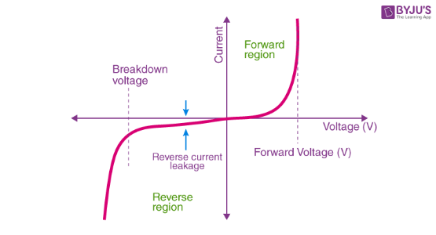
V-I Characteristic Curve
Understanding Behavior
The voltage-current (V-I) curve shows how a diode responds to applied voltage.
•
Quadrant 1 (Forward Bias): Voltage is positive, Current increases exponentially after a threshold.
•
Quadrant 3 (Reverse Bias): Voltage is negative, Current is negligible until breakdown.
Sokoine University of Agriculture
AGE 214 - Lecture 4

Slide 3





Forward Bias & Knee Voltage
Cut-in Voltage (Vk)
Silicon vs Germanium
Behavior
The voltage where significant conduction begins. Also called "Knee Voltage".
Silicon: ~ 0.7 V
Germanium: ~ 0.3 V
Below Vk, current is tiny. Above Vk, current rises rapidly for small voltage increases.
Sokoine University of Agriculture
AGE 214 - Lecture 4

Slide 4

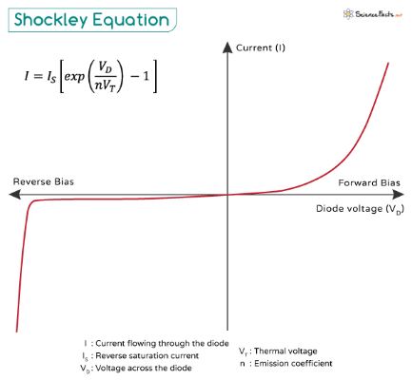
Reverse Bias & Breakdown
Key Parameters
•
Leakage Current (Is): A tiny current (micro/nano-amps) due to minority carriers. Ideally zero.
•
PIV (Peak Inverse Voltage): The max reverse voltage a diode can withstand.
•
Breakdown: If VReverse > PIV, the diode conducts heavily and may be destroyed (Avalanche effect).
Sokoine University of Agriculture
AGE 214 - Lecture 4

Slide 5
The Shockley Diode Equation
Mathematical Model
This equation describes the current (ID) for any applied voltage (VD).
IS: Reverse Saturation Current
n: Ideality Factor (1 to 2)
VD: Applied Voltage
VT: Thermal Voltage (~26mV at 300K)
Sokoine University of Agriculture
AGE 214 - Lecture 4

Slide 6






Diode Resistances
DC (Static) Resistance
AC (Dynamic) Resistance
Resistance at a specific DC operating point.
Resistance to changing signal (slope of curve).
Sokoine University of Agriculture
AGE 214 - Lecture 4

Slide 7
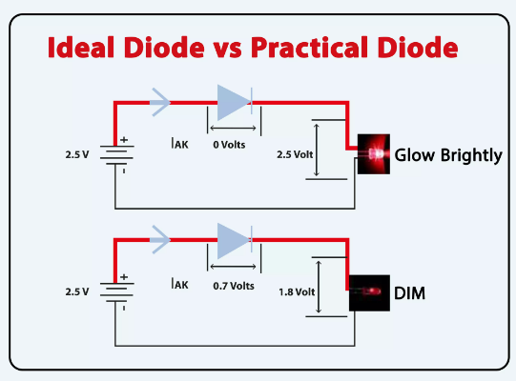
Three Diode Models
Engineers use approximations to simplify circuit analysis.
1.
Ideal Model: Perfect switch. No voltage drop.
2.
Practical Model: Switch + Voltage Drop (0.7V). Most common.
3.
Complete Model: Switch + Voltage Drop + Resistance. Most accurate.
Sokoine University of Agriculture
AGE 214 - Lecture 4

Slide 8
Model Summary
Model | Forward Voltage | Reverse Current | Use Case
Ideal | 0 V | 0 A | Quick Logic Check
Practical | 0.7 V (Si) | 0 A | General Circuit Analysis
Complete | 0.7 V + IDr'd | Leakage (Is) | Precise Simulations
Sokoine University of Agriculture
AGE 214 - Lecture 4

Slide 9
Questions?
Next Lecture: Diode Applications (Rectifiers)
Dr. Kadeghe Fue
Sokoine University of Agriculture
AGE 214 - Lecture 4

Slide 10



https://cdn1.byjus.com/wp-content/uploads/2022/05/V-I-Characteristics-of-P-N-junction-Diode.png
Source: byjus.com
https://www.sciencefacts.net/wp-content/uploads/2024/08/Shockley-Equation.jpg
Source: www.sciencefacts.net
https://images.theengineeringprojects.com/image/webp/2022/05/ideal-diode-vs-practical-diode-1.jpg.webp?ssl=1
Source: www.theengineeringprojects.com

